Slide 1
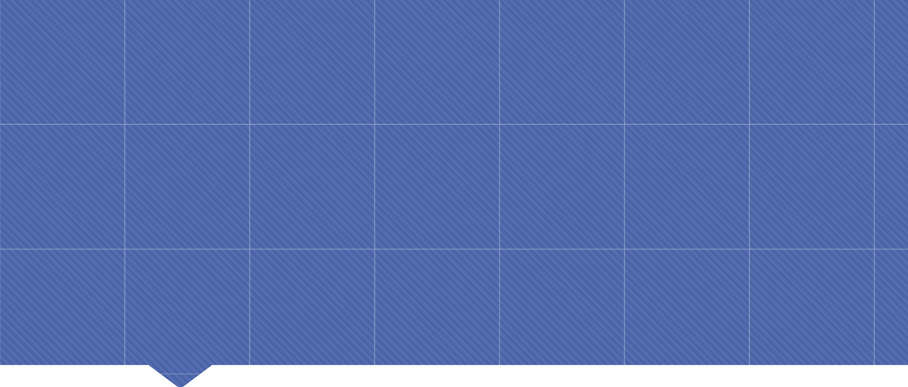
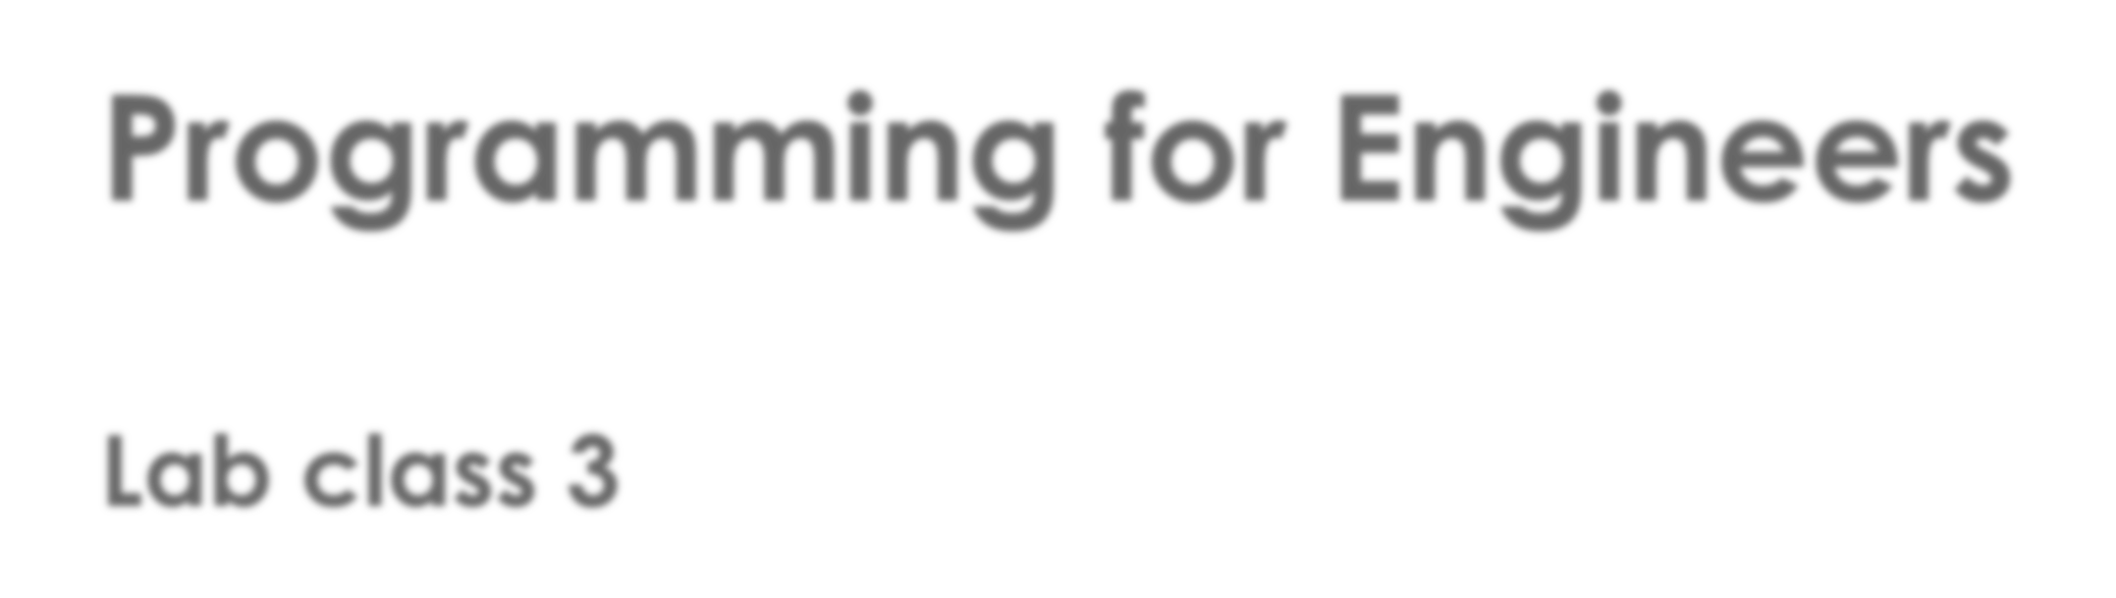
Programming for Engineers
Lab class 3

Slide 2
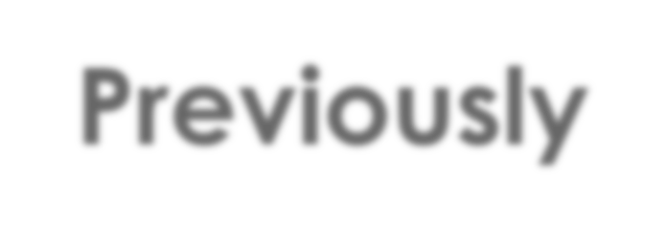
Previously
Making decisions & Handling of text data
 Making choices: Conditional statements
 If-else
instruction1
 Switch
if(money < 12)
{
printf(“Insufficient funds”);
}
else
{
printf(“Thank you!”);
}
Yes
 Operators in expressions
 Relational operators
 Logical operators
?
No
instruction2
instruction3

Slide 3

Last week
Grouping of data, strings, and the concept of loops
instruction1
 Arrays
 Strings in C
 Escape sequences
 Loops
No
?
char c[10] = “Hello!\n”;
Yes
instruction3
instruction2

Slide 4
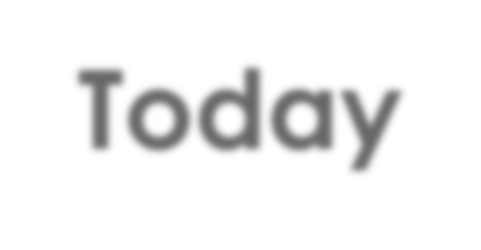
Today
Working with loops; arrays; functions, error types & debugging
 Different types of loops that are available
 How to improve the structure of programs by using functions
 The scope of variables
 Understanding different types of errors
 Using the debugger to detect and get rid of errors in your program
 Multi-dimensional arrays

Slide 5
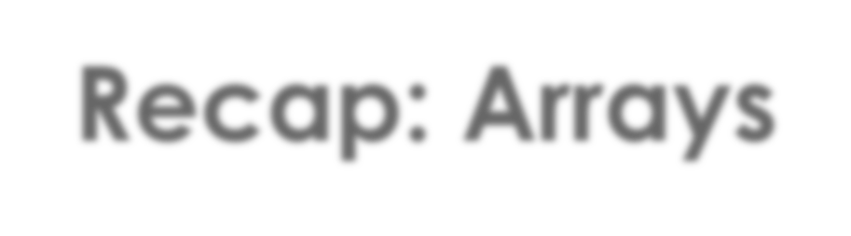
Recap: Arrays
Code Example: Array of integers
int numbers[4];
numbers[0] = 10;
numbers[1] = 45;
10 | 45 | … | …
0
1
2
3

Slide 6

More Control
Loops
 We often want to perform an action multiple times
 Most programming languages include loop statements to make this possible
 Basically, there are three kinds of loops in C:
while loop
 do-while loop
for loop

Slide 7

Loops
While loop
 No explicit control variable, only a condition
 Performance depends on the condition
 Danger of infinite loops if condition never yields false!
while(condition)
{
// instructions to be repeated
// important: include an instruction that affects the condition!
}

Slide 8
Loops
While loop
 No explicit control variable, only a condition
 Performance depends on the condition
 Danger of infinite loops if condition never yields false!
int i = 0; 1
int k = 2;
while( i < k )
{
printf("Turn %d", i);
i++;
}
i = 0
k = 2

Slide 9
Loops
While loop
 No explicit control variable, only a condition
 Performance depends on the condition
 Danger of infinite loops if condition never yields false!
int i = 0; 1
int k = 2;
while( i < k ) 2 true
{
printf("Turn %d", i);
i++;
}
i = 0
k = 2

Slide 10
Loops
While loop
 No explicit control variable, only a condition
 Performance depends on the condition
 Danger of infinite loops if condition never yields false!
int i = 0; 1
int k = 2;
while( i < k ) 2
{
printf("Turn %d", i); 3
i = 1
i++; 4
}
k = 2

Slide 11
Loops
While loop
 No explicit control variable, only a condition
 Performance depends on the condition
 Danger of infinite loops if condition never yields false!
int i = 0; 1
int k = 2;
while( i < k ) 2
{
5 true
i = 1
printf("Turn %d", i); 3
i++; 4
}
k = 2

Slide 12
Loops
While loop
 No explicit control variable, only a condition
 Performance depends on the condition
 Danger of infinite loops if condition never yields false!
int i = 0; 1
int k = 2;
while( i < k ) 2
{
5
i = 2
printf("Turn %d", i); 3 6
i++; 4 7
}
k = 2

Slide 13
Loops
While loop
 No explicit control variable, only a condition
 Performance depends on the condition
 Danger of infinite loops if condition never yields false!
int i = 0; 1
int k = 2;
while( i < k ) 2
{
5
8 false
3 6
i = 2
printf("Turn %d", i);
i++; 4 7
}
exit loop
k = 2

Slide 14
Loops
Do-While loop
 Similar to while-loop with the exception that the loop body is executed
once before the condition is checked
int i = 200;
do {
printf("Enter a number above 100 : ");
scanf("%d", &i);
}
while( i <= 100);
Semicolon here!

Slide 15
Loops
For loop
 Initialises a control variable; matches it against a condition; modifies the control
variable after each loop iteration
 Performance depends on the value of the control variable / condition
for(initialisation; condition; post-loop action)
{
// instructions to be repeated
}

Slide 16
Loops
For loop
 Initialises a control variable; matches it against a condition; modifies the control
variable after each loop
 Performance depends on the value of the control variable / condition
int index, k=2;
1
for(index=0; index < k; index = index + 1)
{
printf("Turn %d", i);
}
index = 0
k = 2

Slide 17
Loops
For loop
 Initialises a control variable; matches it against a condition; modifies the control
variable after each loop
 Performance depends on the value of the control variable / condition
int index, k=2;
1
2 true
for(index=0; index < k; index = index + 1)
{
printf("Turn %d", i);
}
index = 0
k = 2

Slide 18
Loops
For loop
 Initialises a control variable; matches it against a condition; modifies the control
variable after each loop
 Performance depends on the value of the control variable / condition
int index, k=2;
1
2
for(index=0; index < k; index = index + 1)
{
index = 0
printf("Turn %d", index); 3
}
k = 2

Slide 19
Loops
For loop
 Initialises a control variable; matches it against a condition; modifies the control
variable after each loop
 Performance depends on the value of the control variable / condition
int index, k=2;
1
2 4
for(index=0; index < k; index = index + 1)
{
index = 1
printf("Turn %d", index); 3
}
k = 2

Slide 20
Loops
For loop
 Initialises a control variable; matches it against a condition; modifies the control
variable after each loop
 Performance depends on the value of the control variable / condition
int index, k=2;
1
2 5 true 4
for(index=0; index < k; index = index + 1)
{
index = 1
printf("Turn %d", index); 3
}
k = 2

Slide 21
Loops
For loop
 Initialises a control variable; matches it against a condition; modifies the control
variable after each loop
 Performance depends on the value of the control variable / condition
int index, k=2;
1
2 5 4
for(index=0; index < k; index = index + 1)
{
index = 1
printf("Turn %d", index); 3 6
}
k = 2

Slide 22
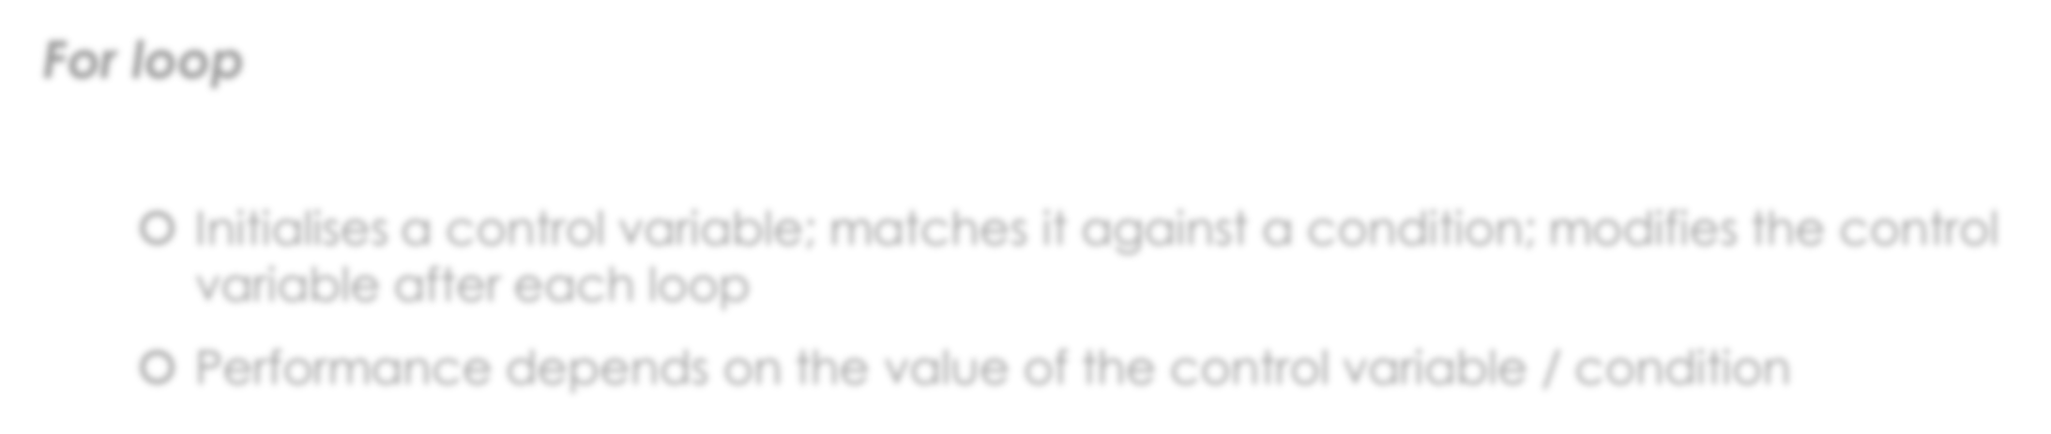
Loops
For loop
 Initialises a control variable; matches it against a condition; modifies the control
variable after each loop
 Performance depends on the value of the control variable / condition
int index, k=2;
1
2 5 4 7
for(index=0; index < k; index = index + 1)
{
index = 2
printf("Turn %d", index); 3 6
}
k = 2

Slide 23
Loops
For loop
 Initialises a control variable; matches it against a condition; modifies the control
variable after each loop
 Performance depends on the value of the control variable / condition
int index, k=2;
1
2 5 8 false
4 7
for(index=0; index < k; index = index + 1)
{
index = 2
printf("Turn %d", index); 3 6
}
exit loop
k = 2

Slide 24
Loops
For loop
 Initialises a control variable; matches it against a condition; modifies the control
variable after each loop
 Performance depends on the value of the control variable / condition
int i, k=2;
for(i=0; i < k; i++)
{
printf("Turn %d", i);
}
Shorter, equivalent code

Slide 25
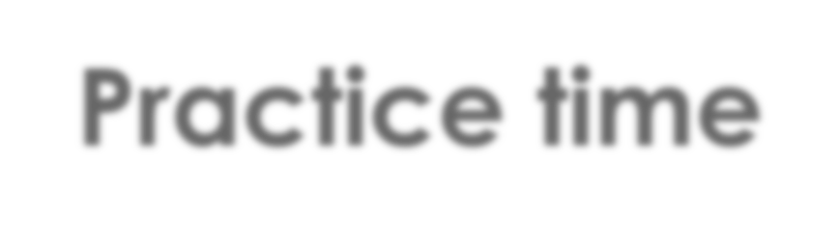
Practice time
Create a program that can add five integers
Create an array of integers to store five numbers in
Use a loop of your choice to ask the user to enter five successive integers and
store these in the array
Use another kind of loop to iterate over and add all numbers stored in the array
Print out on screen the sum
Extension
Make the program "talk" a bit more about what it is doing:
E.g., output details about calculation steps and intermediate results.

Slide 26
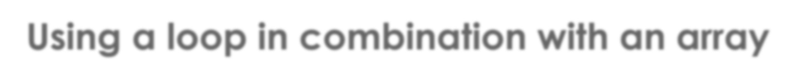
Using a loop in combination with an array
Loops & Arrays: Part 1
 Loops are an excellent way of iterating through the contents of an array
We can use the index (i) of a for-loop to access successive array items and
also to print out status information
int i;
int numbers[5] = { 0 };
printf("Please enter five integers\n\n");
for(i = 0; i <=4; i++) // for-loop, allows i to be between 0 and 4
{
printf("Number %d: ", i+1); // add 1 for sensible output
scanf("%d", &numbers[i]);
}

Slide 27
Using a loop in combination with an array
Loops & Arrays: Part 2
 Loops are an excellent way of iterating through the contents of an array
 We can also use variables manipulated within a while-loop to access specific array items
int k = 0, result = 0;
int length = sizeof(numbers) / sizeof(int); // compute array length
while( k < length) // k must be strictly less than length (maxIndex+1==length)
{
printf("\nI'm adding %d to %d", numbers[k], result);
result += numbers[k]; // same as result=result+numbers[k]
printf(" which gives %d.", result);
k++;
}
printf("\n\nThe sum of all numbers is: %d", result);

Slide 28

More control within loops
break & continue
 We already know break from the switch statement – it interrupts execution within the current
control structure and makes the program continue with the following instruction.
Similarly, break will stop the loop entirely, no matter how many iterations would normally
be left to do, and execution will continue with the next instruction after the loop.
 continue only skips the current turn from the point at which it is placed and will trigger
another evaluation of the condition. In a for-loop, the post-loop action (usually incrementing the control variable) will be run before another evaluation is made.
Experiment with break and continue in your number-adding program.

Slide 29
Practice time
Fibonnacci numbers
 Create a program in C that uses a while- or a for-loop to compute a sequence of
50 Fibonacci numbers (starting from 1) and store the results in an array.
 Then, use another loop to index subsequent parts of the array to print out the
numbers on screen, one after the other, separated by a space symbol
(“ “).
Reflection:
When you run the program, you might notice something odd happening in the sequencing of numbers.
Can you figure out what is happening and why?

Slide 30
Practice time
Create a program that can add five integers
Create an array of integers to store 100 numbers in
Use a loop of to store 100 integers and store these numbers in the array
Use another kind of loop to iterate over and add all numbers with even index stored in the array
if the sum is greater than a fixed nmuber then exit the loop
Print out on screen the sum and the last added number's index before exit from the last loop.
Extension
Make the program "talk" a bit more about what it is doing:
E.g., output details about calculation steps and intermediate results.

Slide 31
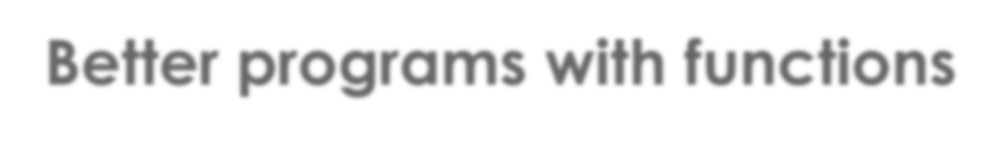
Better programs with functions
Functions
 Functions can be used to structure code by grouping together those actions that
perform a particular task
 Functions make programs more flexible,
and minimize code duplication
 They also make code easier to maintain
A functions can be given parameters as
input, and it will return a result to the point
of call
 We define custom functions outside
of the main function
main() {
instruction;
call to your own function;
another instruction;
...
}
your own function(parameters) {
// do stuff
return some value;
}

Slide 32
Better programs with functions
Function declaration
data_type identifier(data_type parameter1, data_type parameter2, ...)
{
instruction;
another_instruction;
}
 e.g.,
int addTwoIntegers(int a, int b)
{
int result = a + b;
return result;
}

Slide 33
Better programs with functions
Functions
main() {
...
int c = 23;
int d = addTwoIntegers(c,12);
...
} // main function ends here!
// function call
int addTwoIntegers(int a, int b)
{
int result = a + b; return result;
}
// function declaration

Slide 34
Better programs with functions
Functions
Important aspect:
Variables can have different “scope”
main() {
...
int c = 23;
int d = addTwoIntegers(c,12);
...
} // main function ends here!
These variables (c and d) are only
“known” within the current function
// function call
int addTwoIntegers(int a, int b)
{
int result = a + b; return result;
}
// function declaration
These variables are only “known”
within the current function

Slide 35
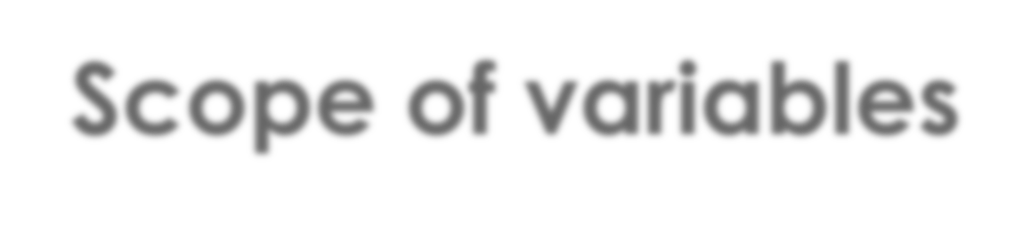
Scope of variables
How does the scope of a variable impact on the availability of its data in the program?
#include <stdio.h>
Global variable:
Specified outside of a function, or control structure.
Will be initialised automatically to some default value (e.g., 0) unless you do it manually.
int a;
int main () {
test();
printf ("The value of global a is %d\n", a);
getchar(); return 0;
Local variable:
Specified within a block of code. Must be initialised manually and will always take precedence over any global variable of the same name.
}
int test() {
int a = 20;
printf ("The value of local a is %d\n", a);
}

Slide 36
Scope of variables
How does the scope of a variable impact on the availability of its data in the program?
#include <stdio.h>
int a = 5;
int main () {
test(10);
printf ("The value of global a is %d\n", a); getchar();
return 0;
}
Function parameters will always behave like local variables: They are also only known within the function they belong to.
int test(int a) {
printf ("The value of local a is %d\n", a);
return 0;
}

Slide 37
Scope of variables
How does the scope of a variable impact on the availability of its data in the program?
#include <stdio.h>
int main () {
int a = 5;
test(a);
getchar();
return 0;
}
This will not compile because the variable a is unknown within the scope of this function.
int test(int x) {
printf ("The value of a is %d\n", a);
printf ("The value of x is %d\n", x);
}

Slide 38
Practice time
Working with functions – let’s create a calculator
Create a program that takes two inputs from the user
An integer x to use as an operand
An integer for choosing a mathematical operation to be carried out, e.g., 1 may be for computing the factorial of x, and 2 could be for determining the square root of x, etc. (Make sure to present a text description of the available choices in the UI)
Create dedicated functions for each mathematical operation
Call the functions in 2. from the main method as required
Use the main method to receive the function return values and print out the results
Extension:
Make the program work with two operands x and y and supply more math functions

Slide 39

More operators
Mathematical operators
Expression | What does it do?
x + y | Adds y to x
x – y | Subtracts y from x
x * y | Multiplies x and y
x / y | Divides x by y
x % y | Performs x modulo y (returns the remainder of the integer division x/y)
x++ | Increments x by 1 (x=x+1)
x-- | Decrements x by 1 (x=x-1)

Slide 40
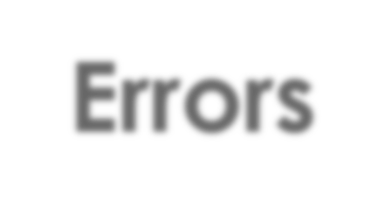
Errors
Syntax errors
 Misspellings in the code, or wrong format
 The compiler will flag up syntax errors
 Syntax errors are relatively easy to fix but spotting their exact location can be tricky sometimes
int x = 12
int result = X + 5;
For(int i=0; i<=x;i++;)
{
if(i == x) { return true;
}

Slide 41
Errors
Syntax errors
Semicolon
missing
Variable not
declared X != x
 Misspellings in the code, or wrong format
 The compiler will flag up syntax errors
 Syntax errors are relatively easy to fix but spotting their exact location can be tricky sometimes
int x = 12
int result = X + 5;
Semicolon incorrect here
For(int i=0; i<=x;i++;)
{
if(i == x) { return true;
}
Wrong spelling
(Capital-F)
Closing bracket missing

Slide 42
Errors
Logical errors
 The formal syntax can be correct yet our program does not work as expected,
e.g. due to:
 Flawed logic
 Flawed implementation
 Flaws in the hardware (rare)
 The compiler won’t notice these errors
 Logical errors may not have an immediately obvious manifestation
 Errors are quite common: Commercial software is rarely free of bugs!

Slide 43
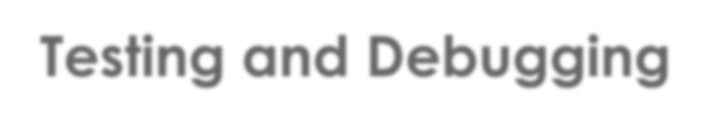
Testing and Debugging
How to get rid of errors
 Testing searches for the presence of errors
 Debugging searches for the source of errors
 The manifestation of an error may well be located some distance from its source!

Slide 44
Testing and Debugging
Common approaches
 printf statements (like our verbatim-output programs)
 Manual walkthroughs
 Unit testing and test automation, e.g. https://sourceforge.net/projects/cunit/
(there are many other frameworks, http://www.opensourcetesting.org)
 Using the Debugger (Breakpoints, step-wise execution, observing state changes)

Slide 45
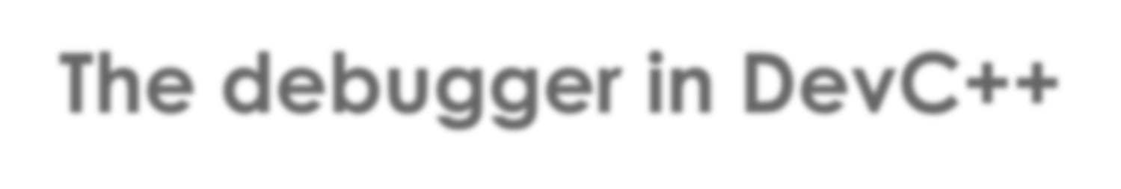
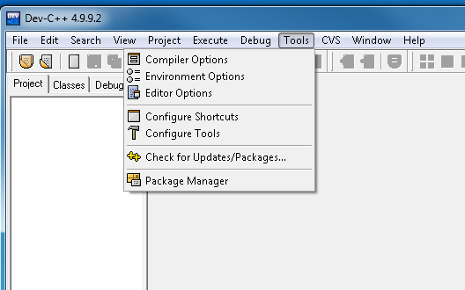
The debugger in DevC++
If it doesn’t work out-of-the-box:

Slide 46
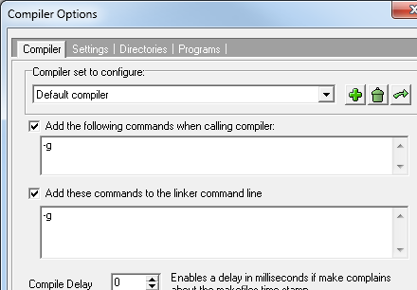
The debugger in DevC++
If it doesn’t work out-of-the-box:

Slide 47
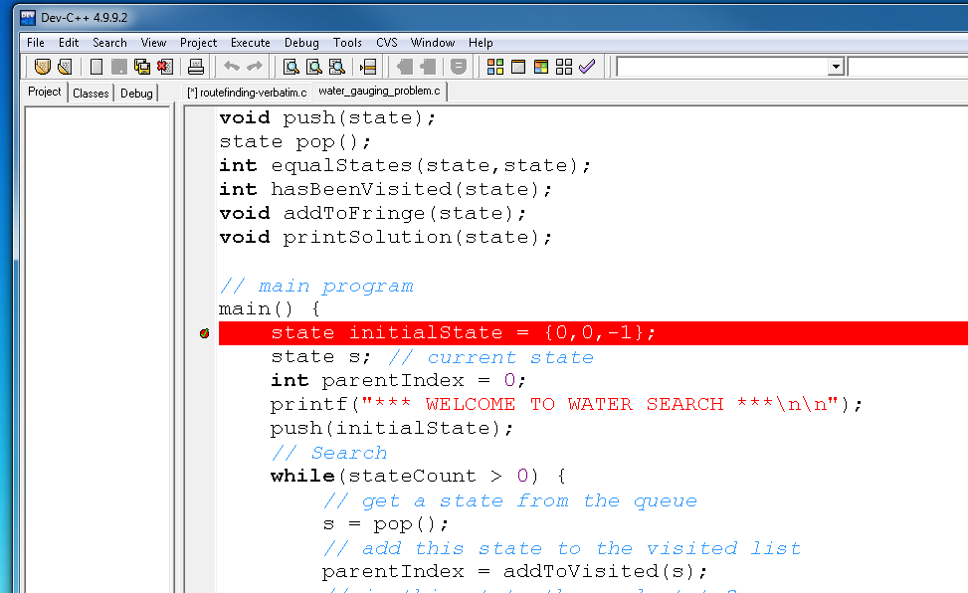
The debugger in DevC++
Debugging tools
Set a “break point”
by clicking here
This will pause execution immediately after this instruction

Slide 48
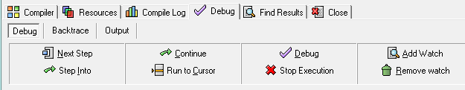
The debugger in DevC++
Debugging tools
 Press F5 to run the debugger
Stepwise execution
Steps “into” functions
Track the values of variables, etc.

Slide 49
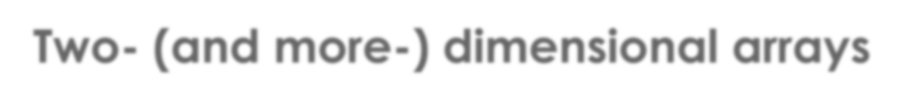
Two- (and more-) dimensional arrays
How do multi-dimensional arrays work?
dim1 size = 3
 We can add more dimensions to an array
0 | 0 | 0
0 | 0 | 0
0 | 0 | 0
0 | 0 | 0
data_type identifier[dim1-size][dim2-size][..];
dim2 size = 4
int numbers[3][4] = { 0 };

Slide 50
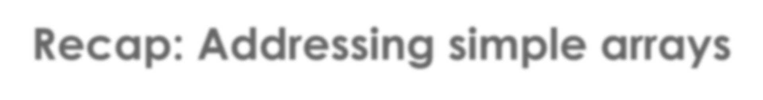
Recap: Addressing simple arrays
Code Example
int numbers[3]; numbers[0] = 10;
numbers[1] = 45;
printf(“%d”, numbers[0]);
10 | 45 | …
0
1
2
Use the index number within square brackets to access a single item

Slide 51
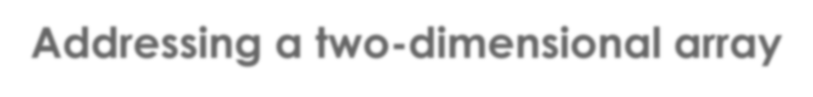
Addressing a two-dimensional array
Code Example
0
1
2
0 | 10 | 0
0 | 0 | 0
0 | 0 | 45
0 | 0 | 0
0
int numbers[3][4] = {0}; numbers[0][1] = 10;
numbers[2][2] = 45;
printf(“%d”, numbers[2][2]);
1
2
3
Use the index numbers within square brackets to access a single item

Slide 52
Practice time
Working with multidimensional arrays (and functions)
Create a program that can add two matrices of the same size.
To do this, define TWO matrices of the same dimensions (e.g., 3 x 3) and fill each location in the matrix with a different integer value (e.g., values 1 to 9 for a 3 x 3 matrix).
Perform the correct addition operation.
Print out the two initial matrices onto the screen, so that they look something like this:
0 1 2
3 4 5
6 7 8
Print out onto screen the matrix that is the result of the addition.

Slide 53
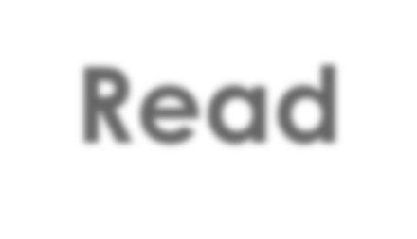
Read
 Kernighan and Ritchie
Section 1.6 & 1.7
Chapter 4

Slide 54
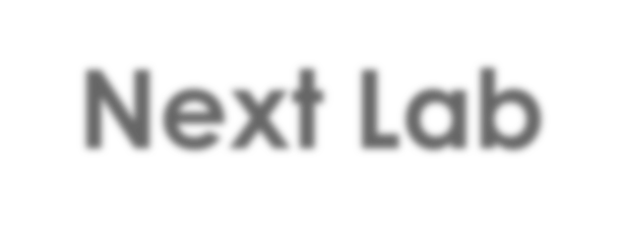
Next Lab
 Problem-solving

